Slide 1
Computer Vision and Image Processing
Tirgul 6
Hough Transform
By Shai Aharon & Moriya Bitton

Slide 2
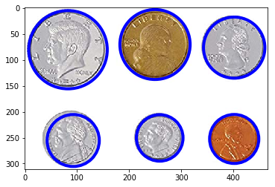
Hough Transform
We’ll use Hough Transform to find any shape that has a parametric equation. For example: straight line, circle, ellipse.
Hough Circle Transform:

Slide 3
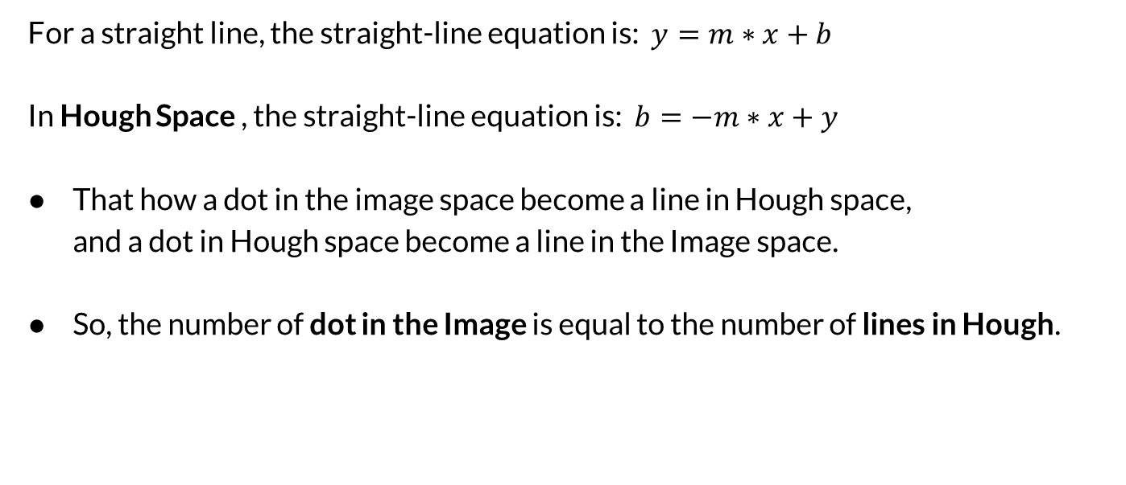
Hough Space
For a straight line, the straight-line equation is: $y=m∗x+b$ In Hough Space , the straight-line equation is: $b=−m∗x+y$
That how a dot in the image space become a line in Hough space, and a dot in Hough space become a line in the Image space.
So, the number of dot in the Image is equal to the number of lines in Hough.

Slide 4
How?
It seems that an infinite number of lines can pass at any point.
Y
b
X
m

Slide 5


Hough Space - Lines
Hough Space can turn infinity lines into 360
using a polar coordinate system:
$$d=x⋅\cos\left(α\right)+y⋅cos⁡(β)$$
Y
b
d
X
m

Slide 6

Which line represents the point?
$$d=x⋅\cos\left(α\right)+y⋅cos⁡(β)$$
Y
Y
?
d
d
X
X

Slide 7
Solution
The point of intersection between two lines in Hough space is a line in the Image space.
So the more lines intersect at that point in the Hough space, the longer the matching line in the Image space.

Slide 8
Hough Space - Lines
Y
Y
d
X
X

Slide 9
Result
Y
Y
d
X
X

Slide 10
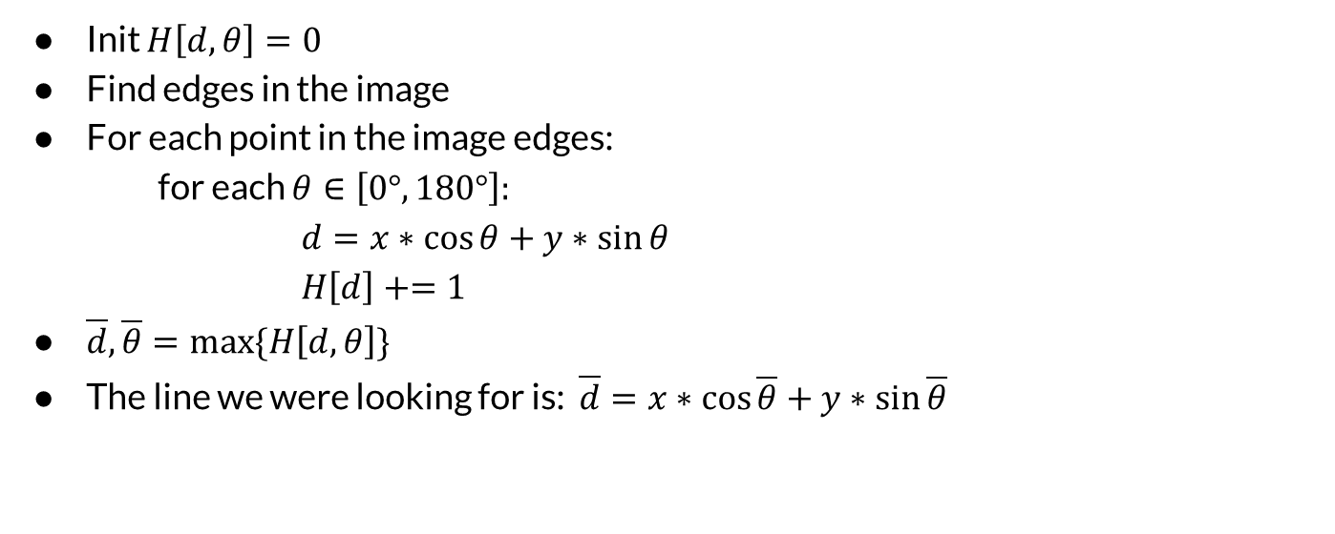
Algorithm - Lines
Init $H\left[d,θ\right]=0$
Find edges in the image
For each point in the image edges: for each $θ∈\left[0°,180°\right]:$ $d=x∗\cos{θ}+y∗\sin{θ}$ $H\left[d\right]+=1$
$\overline{d}, \overline{θ}=\max{\{H\left[d,θ\right]\}}$
The line we were looking for is: $\overline{d}=x∗\cos{\overline{θ}}+y∗\sin{\overline{θ}}$

Slide 11
Now with circles
Y
Y
?
X
X

Slide 12



Now with circles
$${(x−a)}^{2}+{(y−b)}^{2}=r^{2}$$
Y
Y
$$(a,b,R)$$
$$(x,y,0)$$
X
X

Slide 13
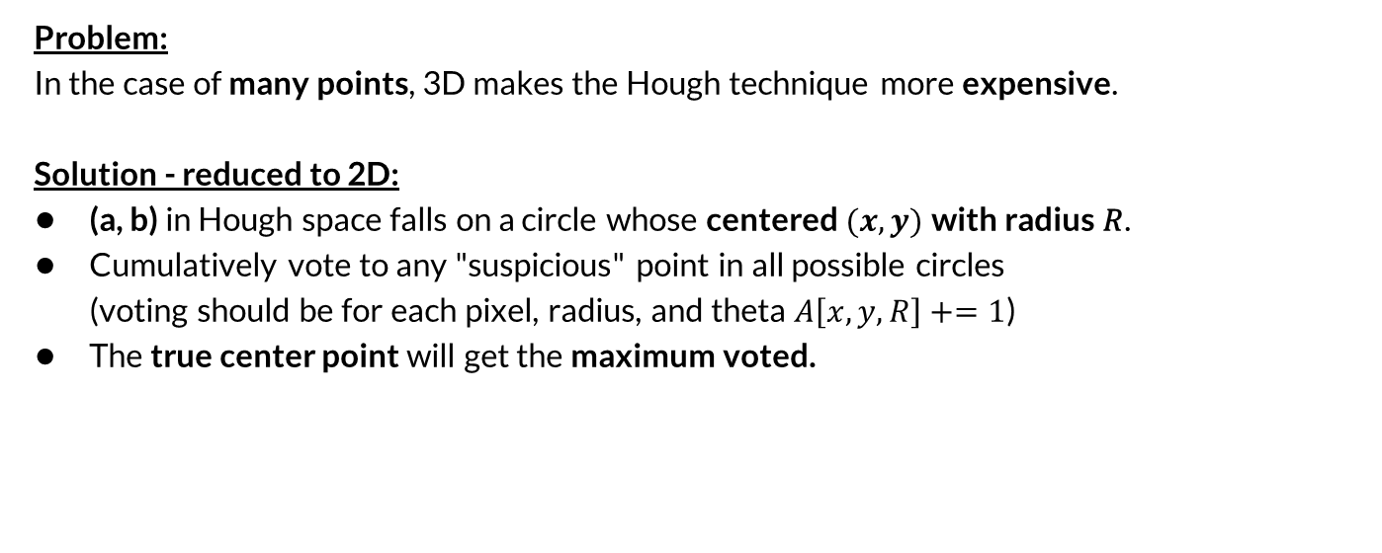
3D → 2D
Problem:
In the case of many points, 3D makes the Hough technique more expensive.
Solution - reduced to 2D:
(a, b) in Hough space falls on a circle whose centered $(x, y)$with radius 𝑅.
Cumulatively vote to any "suspicious" point in all possible circles (voting should be for each pixel, radius, and theta $A\left[x, y, R\right]+=1$)
The true center point will get the maximum voted.

Slide 14

Let’s assume a constant Radius
The Hough transform can be used to determine the parameters of a circle when we have a given radius $R$.
A circle with radius $R$ and $center (a, b)$ can be described with the parametric equations: $x = a + R cos⁡(θ)$ $y = b + R sin⁡(θ)$
When the angle $θ$ sweeps through $360°$, the points $(x, y)$trace the perimeter of a circle.
Y
Y
R
X
X

Slide 15
Let’s assume a constant Radius
Y
Y
R
X
X

Slide 16
Let’s assume a constant Radius
Y
Y
R
X
X

